Slide 1

CNN for Multi-Class Image Classification
ISM6561 Deep Learning
Guardians Of The Galaxy:
Kathryn Burkhart
Prince Praveen
Debjani Sarma

Slide 2

Dataset Overview
This dataset consists of clothing items scrapped from Carousell, an online marketplace and contains 15 classes representing different types of clothing.
Blazer
Celana_Panjang (Long Pants)
Celana_Pendek (Shorts)
Gaun (Dresses)
Hoodie
Jaket (Jacket)
Jaket_Denim (Denim Jacket)
Jaket_Olahraga (Sports Jacket)
Jeans
Kaos (T-shirt)
Kemeja (Shirt)
Mantel (Coat)
Polo
Rok (Skirt)
Sweter (Sweater)
Notes:
This dataset consists of clothing items scraped from Carousell, an online marketplace. It contains 15 distinct classes, each representing a different type of clothing: (list out items)

Slide 3
Data Preprocessing and DataLoader Setup
Seed set to 42 for reproducibility
Apply data augmentation techniques such as rotation and flipping to enhance model generalization
Dataset is standardized by normalizing pixel values
Dataset is split 80/20 for training and validation
Using PyTorch DataLoader, the images are loaded for efficient batching and transformation
Notes:
To ensure optimal model performance, several preprocessing steps were applied to the dataset:
Reproducibility: The seed is set to 42 to maintain consistency in results.
Data Augmentation: Techniques such as rotation and flipping are applied to improve model generalization.
Normalization: Pixel values are standardized to enhance learning stability.
Train-Validation Split: The dataset is divided into 80% training and 20% validation for effective model evaluation.
Efficient Data Loading: PyTorch DataLoader is used to handle batching and transformations, ensuring smooth training.

Slide 4

CNN Model Architecture Experimentation
Configuration tested:
Convolutional Layers: 2, 3, or 4 layers
Filter Sizes: Comparing (32, 64) vs. (64, 128, 256)
Pooling Strategy: Max Pooling vs. Average Pooling
Rationale:
More convolutional layers: Improve feature learning but increase computation cost
Larger filters : Capture spatial hierarchies but need more data
Max Pooling : Preserves key features
Average Pooling : Reduces noise sensitivity
Metrics Tracked
Loss & Accuracy Curves (Train & Validation)
Precision, Recall, F1-score
Weights & Biases Logging
Notes:
To optimize performance, various CNN configurations were tested:
Configurations Tested
Convolutional Layers: 2, 3, or 4 layers
Filter Sizes: Comparing (32, 64) vs. (64, 128, 256)
Pooling Strategy: Max Pooling vs. Average Pooling
Rationale
More Convolutional Layers: Enhance feature learning but increase computational cost.
Larger Filters: Capture spatial hierarchies but require more data.
Max Pooling: Preserves key features.
Average Pooling: Reduces noise sensitivity.
Metrics Tracked
Loss & Accuracy Curves (Training & Validation)
Precision, Recall, and F1-score
Weights & Biases Logging for experiment tracking
These variations help assess the best balance between performance and efficiency.

Slide 5

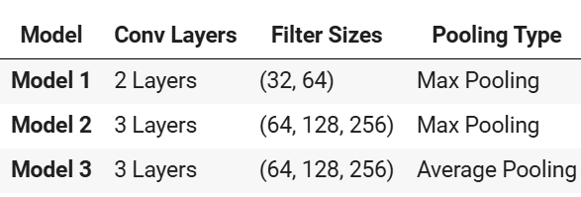
Hyperparameter Tuning Strategy – Prince Praveen
Pros & Cons of Tuning Approach:
End Goal:
Find an optimal balance between model complexity and performance for clothing classification.
Aspect | Pros | Cons
Model Depth | Helps learn complex features | Risk of overfitting
Filter Size | Improves feature detection | More filters = Higher computation time
Pooling Choice | Impact feature retention and noise reduction | Average Pooling may blur edges
Models trained:
Notes:
Pros:
Adjusting depth and filters helps optimize model capacity.
Evaluates whether a deeper or shallower network is more effective for the dataset.
Pooling choices influence feature retention and noise reduction.
Cons:
Deeper models risk overfitting, requiring additional regularization.
More filters enhance feature extraction but significantly increase computation time.
Pooling choices may lead to information loss, affecting model performance.
End Goal
By experimenting with different architectures, we aim to strike a balance between model complexity and performance for classifying clothing items effectively.

Slide 6
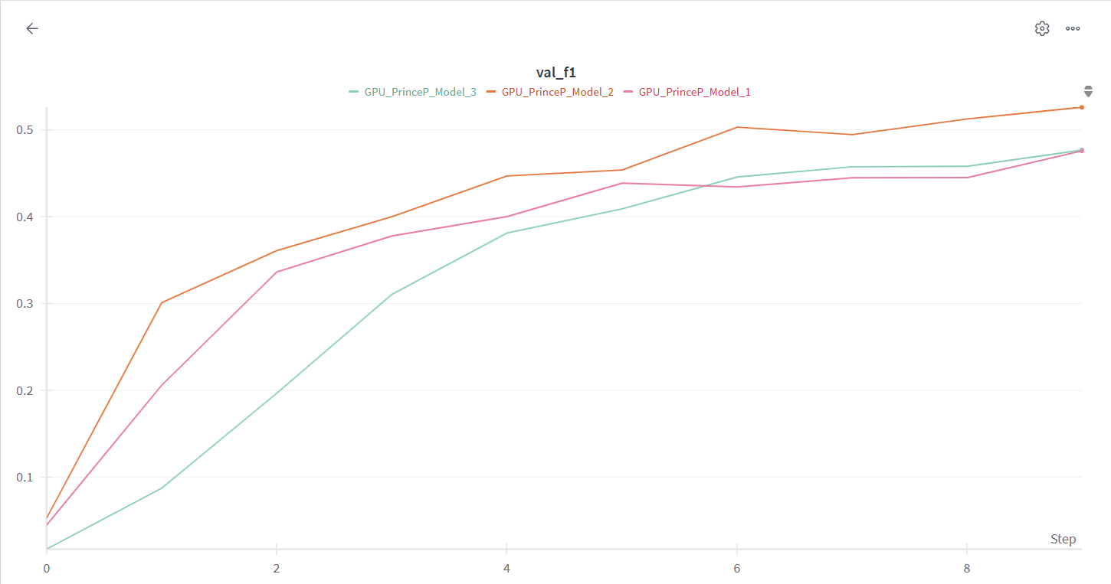
Prince’s Model: Validation Metrics- F1
Model 1
F1: 0.47594
Model 2
F1: 0.5261
Model 3
F1: 0.4768

Slide 7
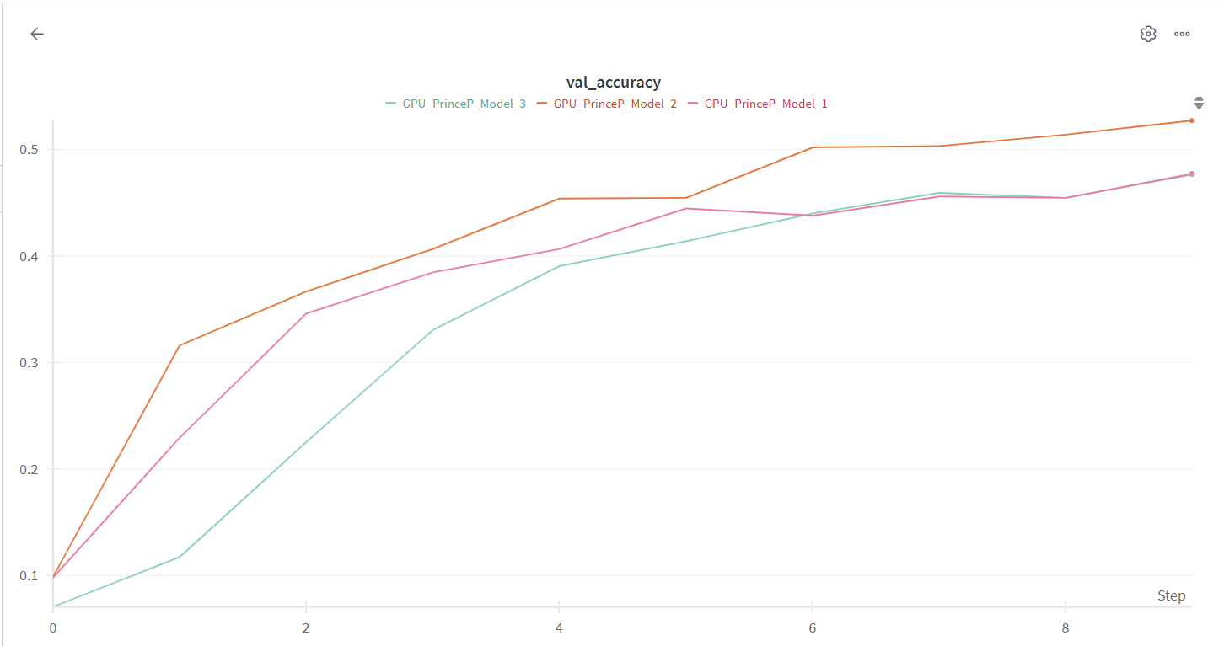
Prince’s Model: Validation Metrics- Accuracy
Model 1
Accuracy: 0.47733
Model 2
Accuracy: 0.5273
Model 3 Accuracy: 0.4768

Slide 8

Regularization Tuning – Kathryn Burkhart
Objective: Improve generalization & prevent overfitting
Tuning Choices:
Dropout Rate:
Dropout prevents overfitting by randomly disabling neurons during training.
0.3 (light regularization) vs 0.5 (moderate regularization)
Weight decay (L2 Regularization):
Penalizes large weight values to avoid overfitting
1e-5 for selected models
Batch Normalization:
Batch normalization helps stabilize training and speeds up convergence
Compare: With Batch Norm and Without Batch Norm
Notes:
Enhance generalization and prevent overfitting by applying regularization techniques.
Tuning Choices
Dropout Rate:
Dropout helps prevent overfitting by randomly disabling neurons during training.
Tested Rates:
0.3 → Light regularization
0.5 → Moderate regularization
Weight Decay (L2 Regularization):
Penalizes large weight values to prevent overfitting.
Applied a light weight decay of 1e-5 to selected models.
Batch Normalization:
Stabilizes training and speeds up convergence.
Comparison:
With Batch Norm
Without Batch Norm

Slide 9
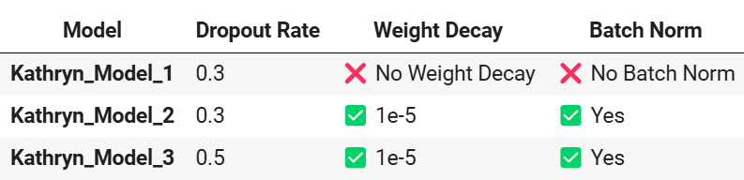
Regularization Tuning – Kathryn Burkhart
Pros & Cons of Approach:
Method | Pros | Cons
Dropout | Prevents overfitting by reducing reliance on specific neurons | Too much (0.5) may cause underfitting
Weight Decay (L2) | Helps control large weight values | High values can restrict learning
Batch Normalization | Stabilizes training, reduces dependence on dropout | Adds extra computation cost
End Goal: Identify the best approach that minimizes overfitting without sacrificing accuracy.
Notes:
Pros:
Helps prevent overfitting, ensuring better generalization.
Finds the optimal balance of regularization for improved performance.
Batch Normalization stabilizes training and reduces dependence on dropout.
Cons:
High dropout (0.5) may lead to underfitting.
Excessive weight decay can limit learning capacity.
Batch Normalization adds extra computation, slightly slowing down training.
End Goal:
Identify the best regularization strategy that minimizes overfitting while maintaining accuracy.

Slide 10
Regularization Tuning (Model 1 Findings) – Kathryn Burkhart
Model Info:
Dropout Rate: 0.3
Weight Decay: NO
Batch Norm: NO
Training vs. Validation Performance:
Accuracy: 64.98% (Train) vs. 51.93% (Validation) → Indicates overfitting.
F1-score: 0.647 (Train) vs. 0.523 (Validation) → Model struggles with unseen data, likely misclassifying certain classes.
Loss Analysis:
Training Loss (1.08) < Validation Loss (1.59) → Reinforces overfitting, suggesting poor generalization.
Architectural Insights:
Dropout (0.3): Helps, but not sufficient to prevent overfitting.
No Batch Norm: May hinder stability and generalization.
No Weight Decay: Allows potential overfitting due to unpenalized large weights.
Leaky ReLU: Improves gradient flow but may need further tuning.
Notes:
Model Overview
Dropout Rate: 0.3
Weight Decay: Not Applied
Batch Normalization: Not Applied
Training vs. Validation Performance
Accuracy: 64.98% (Train) vs. 51.93% (Validation) → Signs of overfitting.
F1-score: 0.647 (Train) vs. 0.523 (Validation) → Model struggles with unseen data, likely misclassifying certain classes.
Loss Analysis
Training Loss (1.08) < Validation Loss (1.59) → Further confirms overfitting and weak generalization.
Architectural Insights
Dropout (0.3): Helps, but not enough to fully control overfitting.
No Batch Norm: May hinder stability and reduce generalization.
No Weight Decay: Allows unpenalized large weights, increasing overfitting risk.
Leaky ReLU: Helps gradient flow, but may need further tuning.

Slide 11
Regularization Tuning (Model 2 Findings) – Kathryn Burkhart
Model Info:
Dropout Rate: 0.3
Weight Decay: 1e-5
Batch Norm: YES
Training vs. Validation Performance:
Accuracy: 34.4% (Train) vs. 35.6% (Validation) → Indicates underfitting; model struggles to learn meaningful patterns.
F1-score: 0.339 (Train) vs. 0.342 (Validation) → Poor class-wise performance, reinforcing ineffective learning.
Loss Analysis:
Training Loss (2.10) ≈ Validation Loss (2.07) → High loss across both, suggesting difficulty in minimizing classification errors.
Architectural Insights:
Batch Norm: Should aid stability, but performance remains poor
Dropout (0.3): Helps regularization, but the model is still underfitting.
Weight Decay (1e-5): Present, but adjustments may be needed.
Leaky ReLU: Provides better gradient flow, yet overall learning remains weak.
Notes:
Model Overview
Dropout Rate: 0.3
Weight Decay: 1e-5
Batch Normalization: Applied
Training vs. Validation Performance
Accuracy: 34.4% (Train) vs. 35.6% (Validation) → Underfitting, model struggles to learn meaningful patterns.
F1-score: 0.339 (Train) vs. 0.342 (Validation) → Poor class-wise performance, reinforcing ineffective learning.
Loss Analysis
Training Loss (2.10) ≈ Validation Loss (2.07) → High loss across both, suggesting difficulty in minimizing classification errors.
Architectural Insights
Batch Norm: Should aid stability, yet performance remains poor.
Dropout (0.3): Helps prevent overfitting, but model still underfits.
Weight Decay (1e-5): Present, but may require further tuning.
Leaky ReLU: Supports gradient flow, but overall learning remains weak.

Slide 12
Regularization Tuning (Model 3 Findings) – Kathryn Burkhart
Model Info:
Dropout Rate: 0.5
Weight Decay: 1e-5
Batch Norm: YES
Training vs. Validation Performance:
Accuracy: 27.22% (Train) vs. 31.60% (Validation) → Indicates severe underfitting; the model struggles to learn meaningful patterns.
F1-score: 0.267 (Train) vs. 0.295 (Validation) → Poor class-wise performance, reinforcing ineffective learning.
Loss Analysis:
Training Loss (2.26) > Validation Loss (2.20) → Suggests that while the model is not overfitting, it is struggling to reduce classification errors effectively.
Architectural Insights:
Batch Normalization: Should stabilize training, but performance remains poor.
Dropout (0.5): Likely too aggressive, contributing to underfitting.
Weight Decay (1e-5): Present, but adjustments may be necessary.
Leaky ReLU: Improves gradient flow, yet learning is still ineffective.
This underfitting suggests that the model lacks sufficient complexity or is overly regularized, limiting its ability to learn key patterns.
Notes:
Model Overview
Dropout Rate: 0.5
Weight Decay: 1e-5
Batch Normalization: Applied
Training vs. Validation Performance
Accuracy: 27.22% (Train) vs. 31.60% (Validation) → Severe underfitting, model struggles to learn meaningful patterns.
F1-score: 0.267 (Train) vs. 0.295 (Validation) → Poor class-wise performance, highlighting ineffective learning.
Loss Analysis
Training Loss (2.26) > Validation Loss (2.20) → Indicates that while not overfitting, the model is struggling to reduce classification errors effectively.
Architectural Insights
Batch Normalization: Should aid stability, yet performance remains poor.
Dropout (0.5): Likely too aggressive, contributing to underfitting.
Weight Decay (1e-5): Present, but may need adjustment.
Leaky ReLU: Supports gradient flow, but overall learning is ineffective.
Key Insight:
The underfitting suggests the model lacks sufficient complexity or is over-regularized, limiting its ability to learn important patterns.

Slide 13
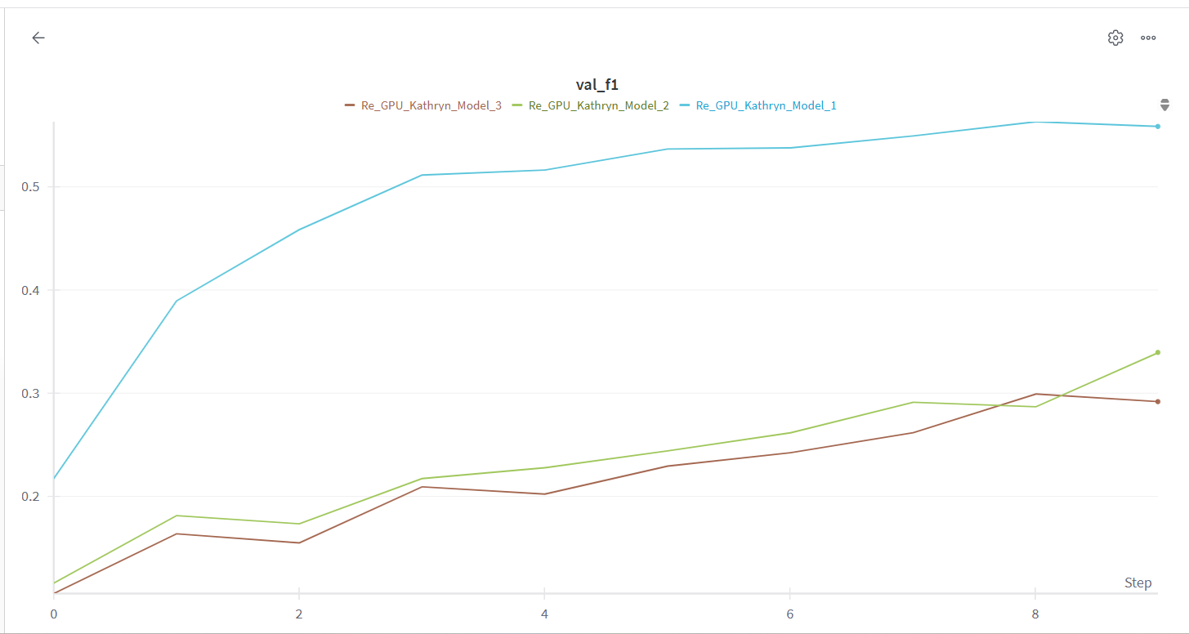
Kathryn’s Models: Validation Metrics – F1
Model 1 F1: 0.51972
Model 2 F1: 0.33952
Model 3 F1: 0.29182

Slide 14
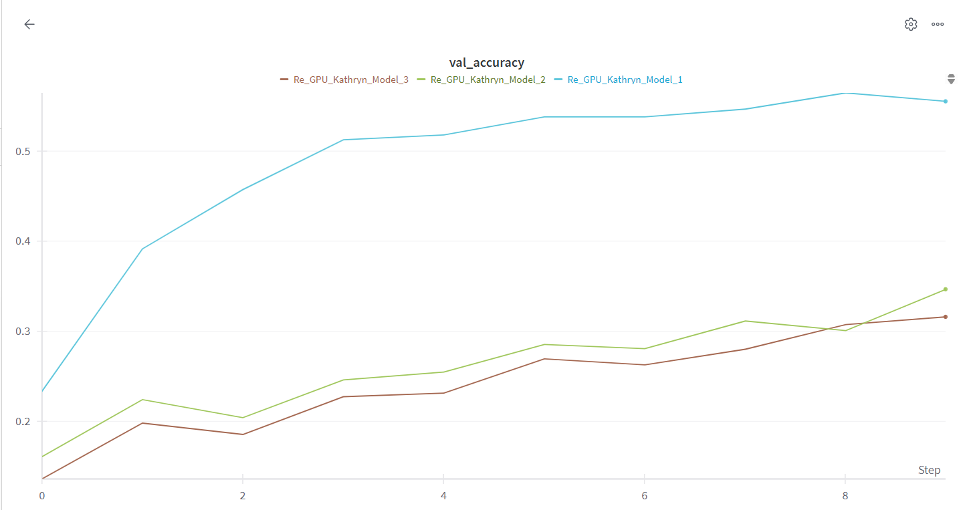
Kathryn’s Models: Validation Metrics – Accuracy
Model 1 Accuracy: 0.518
Model 2 Accuracy: 0.34667
Model 3 Accuracy: 0.316

Slide 15
Optimization & Training Strategy – Debjani Sarma
Objective: Optimize Training Performance by fine-tuning
Learning Rate (LR)
Optimizer Choice
Batch Size

Slide 16

Optimization & Training Strategy – Debjani Sarma
Base Model Selection
This refined model will consist of:
Best CNN architecture from Prince (Leaky ReLU, Avg Pooling, Xavier Init) Best regularization setup from Kathryn (Model 1) (Dropout 0.3, No Weight Decay, No Batch Norm)
This means we are only optimizing training strategy now.

Slide 17

Optimization & Training Strategy – Debjani Sarma
Tuning Choices:
Learning Rate (LR)
Controls step size during weight updates.
0.001 (default, standard step size) vs 0.0005 (smaller steps, may improve stability)
Optimizer Choice
Determines how gradients are used to update model weights.
Adam (adaptive learning, faster convergence) vs SGD (traditional optimizer, better generalization)
Batch Size
Defines how many images the model processes before updating weights.
32 (default, balanced approach) vs 64 (larger, potentially speeds up training)
Notes:
Tuning Choices
Learning Rate (LR): Controls how fast the model updates its weights. We will test:
0.001: Standard step size (default).
0.0005: Smaller steps, may improve stability.
Optimizer Choice: Determines how gradients are used to update model weights. We will compare:
Adam: Adaptive learning, faster convergence.
SGD: Traditional optimizer, may lead to better generalization.
Batch Size: Defines how many images the model processes before updating weights. We will test:
32: Default, balanced approach.
64: Larger batch size, potentially speeds up training.

Slide 18
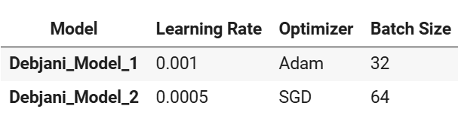
Optimization & Training Strategy – Debjani Sarma
Pros & Cons of Approach
Strategy | Pros | Cons
Smaller Learning Rate (0.0005) | More stable updates | Slower convergence
Adam Optimizer | Fast convergence | May overfit
SGD Optimizer | Better generalization | May require additional tuning (momentum, LR scheduling)
Larger Batch Size (64) | Faster training | Higher memory usage
End Goal: To find the best training configuration that results in fast convergence, stable training, and improved performance.
Notes:
Pros:
Helps determine optimal training speed vs. stability.
Different optimizers can impact convergence and final accuracy.
Batch size affects performance and generalization—testing different sizes ensures a balanced trade-off.
Cons:
SGD may require additional tuning (momentum, LR scheduling) for optimal performance.
Larger batch sizes require more memory, potentially causing GPU constraints.
Very small learning rates may slow down training too much, reducing efficiency.
End Goal:
By adjusting the optimizer, learning rate, and batch size, we aim to find the best training configuration that results in:
Fast convergence
Stable training
Improved performance

Slide 19
Optimization & Training Strategy (Model 1 Findings) – Debjani Sarma
Training Performance:
Train Accuracy: 67.3% → Model correctly classifies 67.3% of training samples.
Train F1-score: 0.67 → Balanced performance across different clothing categories.
Train Loss: 1.00 → Relatively low (model is learning the patterns in the training data well.
Validation Performance:
Validation Accuracy: 53.1% → Lower than the training accuracy, which may indicate overfitting.
Validation F1-score: 0.53 → Model struggles to maintain balanced classification across all categories in the validation set.
Validation Loss: 1.63 → Higher than the training loss (1.00), confirming overfitting since the model is performing well on training data but generalizing poorly.
Overfitting Signs:
Train accuracy (67%) is much higher than validation accuracy (53%).
Train loss (1.00) is much lower than validation loss (1.63).
The gap between train F1-score (0.67) and validation F1-score (0.53) suggests that the model is fitting too closely to the training data but failing to generalize.
Notes:
Training Performance:
Train Accuracy: 67.3% The model correctly classifies 67.3% of training samples, indicating decent performance on the training set.
Train F1-score: 0.67 This score shows balanced performance across different clothing categories, though there’s still room for improvement.
Train Loss: 1.00 The relatively low loss suggests that the model is learning the patterns in the training data effectively.
Validation Performance:
Validation Accuracy: 53.1% The model only correctly classifies 53.1% of validation samples, which is significantly lower than the training accuracy, indicating possible overfitting.
Validation F1-score: 0.53 The model struggles with maintaining balanced classification across all categories in the validation set.
Validation Loss: 1.63 Higher than the training loss, reinforcing the overfitting issue as the model generalizes poorly on unseen data.
Overfitting Signs:
The train accuracy (67%) is much higher than the validation accuracy (53%).
The train loss (1.00) is significantly lower than the validation loss (1.63).
The gap between train F1-score (0.67) and validation F1-score (0.53) suggests the model is overfitting, fitting too closely to the training data but failing to generalize to new data.

Slide 20
Optimization & Training Strategy (Model 2 Findings) – Debjani Sarma
Training Performance:
Train Accuracy: 24.33% → Model is struggling to capture patterns in the training data effectively.
Train F1-score: 0.23 → F1-score is very low, suggesting poor balance between precision and recall, meaning it's not distinguishing between categories well.
Train Loss: 2.33 → Relatively high training loss implies that the model is not learning the patterns in the data efficiently.
Validation Performance:
Validation Accuracy: 24.33% → Identical to the training accuracy, which shows that the model is not generalizing well to unseen data.
Validation F1-score: 0.23 → Similar to training, the F1-score is very low, indicating poor classification balance on the validation set.
Validation Loss: 2.29 → Almost equal to training loss, confirming the model is not improving its performance or generalization.
Underfitting Signs:
Train Accuracy (24.33%) is equal to Validation Accuracy (24.33%), suggesting that the model is not learning well on the training set or generalizing to the validation set.
Train Loss (2.33) is very close to Validation Loss (2.29), indicating that the model isn't improving its learning or generalization over time.
The gap between train F1-score (0.23) and validation F1-score (0.23) shows that the model is unable to capture meaningful patterns in both training and validation data, suggesting a need for architectural and hyperparameter adjustments.
Notes:
Training Performance:
Train Accuracy: 24.33% The model correctly classifies only 24.33% of training samples. This is quite low, indicating that the model is struggling to capture patterns in the training data.
Train F1-score: 0.23 The very low F1-score suggests poor balance between precision and recall, meaning the model is not distinguishing between categories effectively.
Train Loss: 2.33 The relatively high training loss implies that the model is not learning the patterns in the data efficiently.
Validation Performance:
Validation Accuracy: 24.33% The model correctly classifies only 24.33% of validation samples, which is identical to the training accuracy. This indicates that the model is not generalizing well to unseen data.
Validation F1-score: 0.23 Similar to training, the F1-score is very low, suggesting poor classification balance on the validation set.
Validation Loss: 2.29 The validation loss is almost identical to the training loss, confirming that the model is not improving its generalization over time.
Overfitting Signs:
The train accuracy (24.33%) equals the validation accuracy (24.33%), suggesting that the model is neither learning effectively on the training set nor generalizing to the validation set.
The train loss (2.33) is very close to the validation loss (2.29), showing that the model is stuck and not improving during training.
The gap between train F1-score (0.23) and validation F1-score (0.23) further indicates that the model is unable to capture meaningful patterns in both datasets, suggesting that architectural and hyperparameter adjustments are needed.

Slide 21
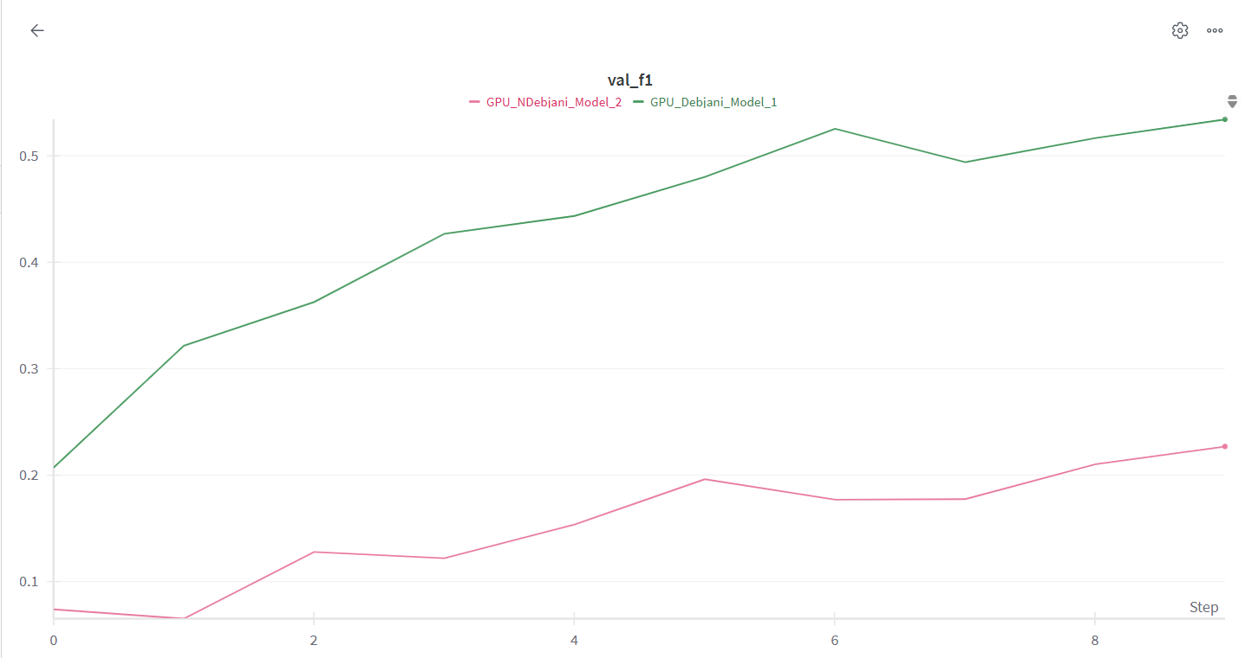
Debjani’s Model : Validation Metrics - F1-score
Model 1
F1-score: 0.53
Model 2
F1-score : 0.243

Slide 22
Debjani’s Model : Validation Metrics - Accuracy
Model 1
Accuracy: 0.531
Model 2
Accuracy: 0.23

Slide 23

Hyperparameter Sweep – Optimized CNN Training
Objective: Automate hyperparameter tuning using Weights & Biases (W&B) sweeps to find the best training configuration for our CNN model
Rationale:
Test multiple hyperparameter combinations efficiently
Log and compare different runs in W&B
Identify the best configuration that maximizes model performance
What are we tuning?
Debjani_Model_1 and we are sweeping across different parameters

Slide 24
Steps in This Hyperparameter Sweep
Define a W&B Sweep Configuration
Specifies which hyperparameters to search over.
Defines how many runs to test.
Selects F1-score as the metric to optimize.
Create a Training Function
Builds the CNN model.
Uses hyperparameters from the W&B sweep.
Logs per-epoch training & validation metrics.
Logs final performance metrics.
Run the Sweep
Automatically runs 10 experiments with different hyperparameter values.
Logs results in W&B for easy comparison.
Notes:
1. Define a W&B Sweep Configuration
Specifies which hyperparameters to search over.
Defines how many runs to test.
Selects F1-score as the metric to optimize, ensuring we focus on balanced performance across categories.
2. Create a Training Function
Builds the CNN model using the architecture defined.
Uses hyperparameters from the W&B sweep to experiment with different configurations.
Logs per-epoch training and validation metrics to monitor the model's progress.
Logs final performance metrics for easy comparison across experiments.
3. Run the Sweep
Automatically runs 10 experiments with different hyperparameter values to explore the search space.
Logs results in W&B for easy comparison, helping us identify the optimal configuration based on performance.

Slide 25

Logging & Visualization
Per-Epoch Logging
Training Loss, Validation Loss
Training & Validation F1 Score
Training & Validation Accuracy
Final Metrics
F1-score and Accuracy in W&B for each run.
End Goal: Identify the best combination of learning rate, batch size, optimizer, and regularization settings which will help us train a more optimized CNN model with better performance

Slide 26
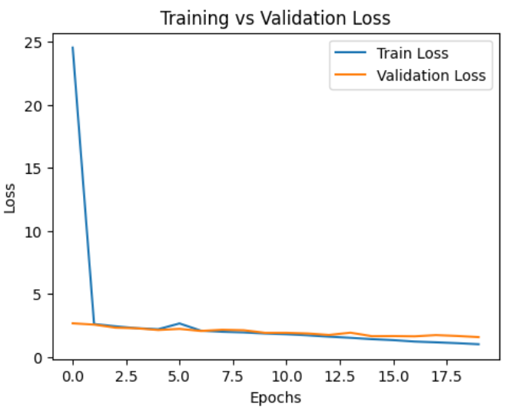
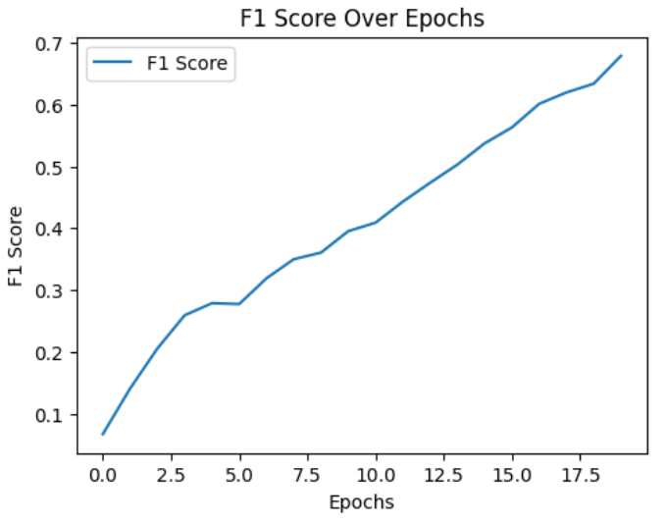
Model 1: Hyperparameter Sweep with RMSprop Optimizer
Hyperparameters:
Batch Size: 32 , Dropout Rate: 0.4, Epochs: 20, Learning Rate: 0.001, Optimizer: RMSprop, Weight Decay: 0.00001
Training Performance:
Train Accuracy: 68.05%
Train F1-Score: 0.68
Train Loss: 1.01
Validation Performance:
Validation Accuracy: 53.93%
Validation F1-Score: 0.53
Validation Loss: 1.57
Overfitting Signs :
Train Accuracy (68.05%) > Validation Accuracy (53.93%), which points to potential overfitting.
Train Loss (1.01) < Validation Loss (1.57): Model’s struggles to generalize well to the validation set.
The Train F1-Score (0.68) > Validation F1-Score (0.53) : Model is memorizing the training data but failing to generalize effectively.
Notes:
Model 1 results:
This model, using RMSprop with the specified hyperparameters, shows signs of overfitting, as evidenced by the significant gap between the training and validation performance. While the model performs well on the training data (with an accuracy of 68.05%), it struggles with generalization, as seen in the validation accuracy (53.93%). To improve, consider exploring techniques like regularization, data augmentation, or further tuning of the learning rate and optimizer to prevent overfitting.

Slide 27
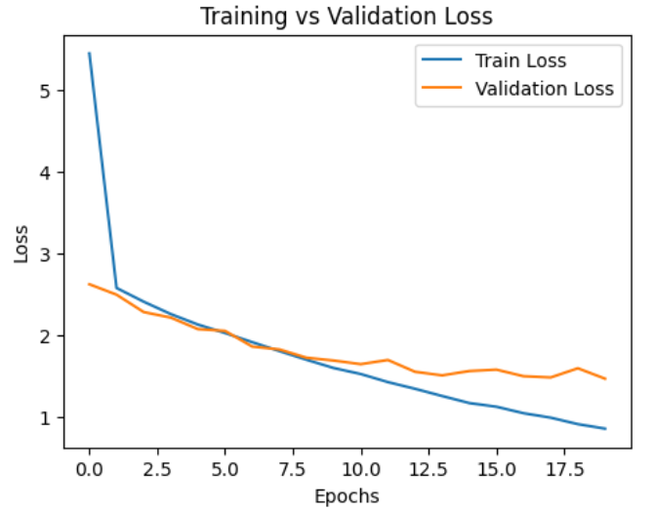
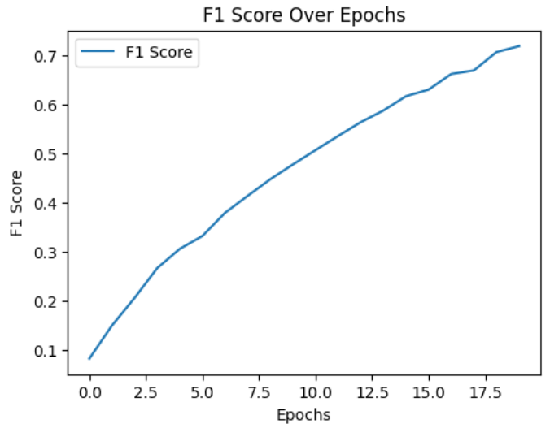
Model 2: Hyperparameter Sweep with RMSprop Optimizer
Hyperparameters:
Batch Size: 64, Dropout Rate: 0.5, Epochs: 20, Learning Rate: 0.0005, Optimizer: RMSprop, Weight Decay: 0
Training Performance:
Train Accuracy: 71.93%
Train F1-Score: 0.72
Train Loss: 0.86
Validation Performance:
Validation Accuracy: 56.80%
Validation F1-Score: 0.57
Validation Loss: 1.47
Overfitting Signs:
Train Accuracy (71.93%) > Validation Accuracy (56.80%): Model may be overfitting the training data.
Train Loss (0.86) < Validation Loss (1.47): Model fits the training data more effectively than the validation data.
The Train F1-Score (0.72) > Validation F1-Score (0.57): Reinforcing the idea of overfitting, where the model performs better on training data but struggles to generalize to new data.
Notes:
Model 2 results:
This model, while showing decent performance on the training data (71.93% accuracy and 0.72 F1-score), faces overfitting issues as evidenced by the drop in performance on the validation set (56.80% accuracy and 0.57 F1-score). The model's training loss is also lower than the validation loss, confirming that the model may have become too specialized in the training data. To combat overfitting, consider exploring further regularization, more diverse training data, or experimenting with other optimizers and learning rates.
Model 3 results:

Slide 28
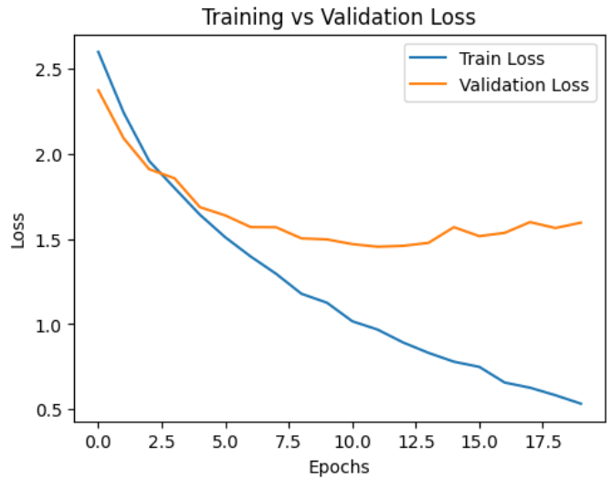
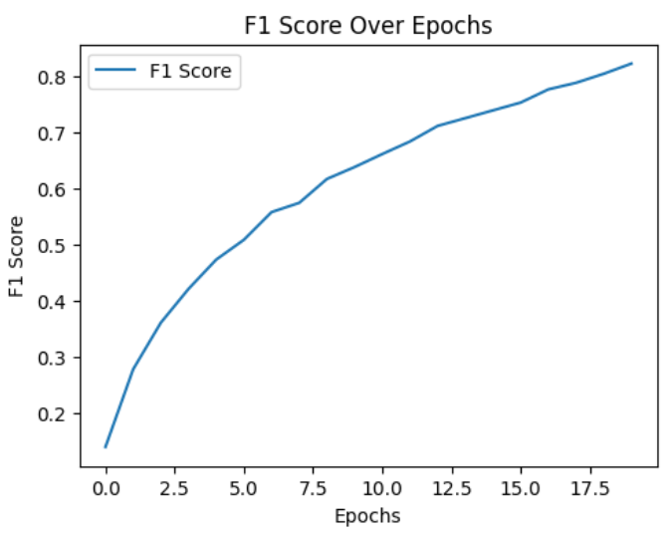
Model 3: Hyperparameter Sweep with Adam Optimizer
Hyperparameters:
Batch Size: 64, Dropout Rate: 0.5, Epochs: 20, Learning Rate: 0.0005, Optimizer: Adam, Weight Decay: 0.00001
Training Performance:
Train Accuracy: 82.32
Train F1-Score: 0.82
Train Loss: 0.53
Validation Performance:
Validation Accuracy: 58.73%
Validation F1-Score: 0.59
Validation Loss: 1.60
Overfitting Signs:
Train Accuracy (82.32%) > Validation Accuracy (58.73%), which points to potential overfitting.
Train Loss (0.53) < Validation Loss (1.60) : Possibility of overfitting.
The Train F1-Score (0.82) > Validation F1-Score (0.59), further confirming the trend of the model excelling on the training data but not generalizing as effectively to new data.
Notes:
Model 3 results:
This model shows strong performance on the training set (82.32% accuracy and 0.82 F1-score), but like the previous models, it exhibits overfitting. The validation performance (58.73% accuracy and 0.59 F1-score) lags behind the training results, indicating that the model has learned the training data too well and struggles to generalize. The difference in loss between training and validation data supports the overfitting hypothesis. To improve the model’s generalization ability, consider adjusting the model’s regularization, data augmentation, or reducing the number of trainable parameters.

Slide 29
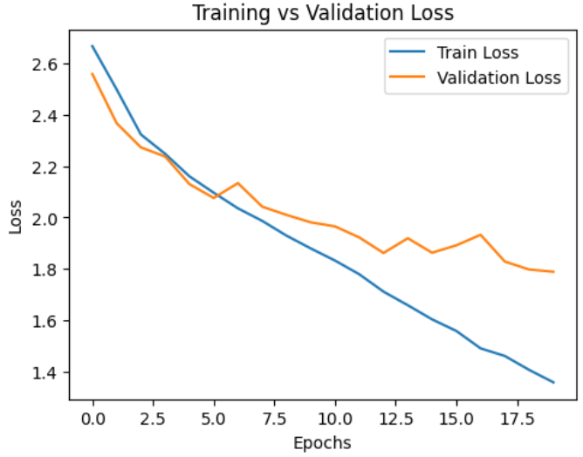
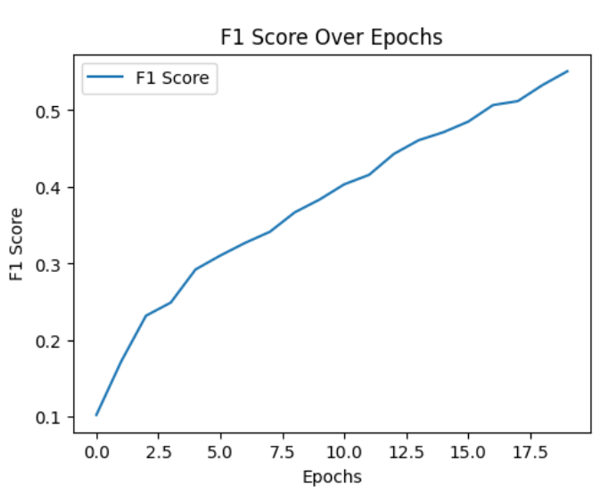
Model 4: Hyperparameter Sweep with SGD Optimizer
Hyperparameters:
Batch Size: 64, Dropout Rate: 0.2, Epochs: 20, Learning Rate: 0.005, Optimizer: SGD, Weight Decay: 0.00001
Training Performance:
Train Accuracy: 55.50%
Train F1-Score: 0.55
Train Loss: 1.36
Validation Performance:
Validation Accuracy: 44.07%
Validation F1-Score: 0.44
Validation Loss: 1.79
Model Behavior:
Overfitting: There isn’t a clear indication of overfitting here because the train and validation performances are similarly low. This suggests that the model isn't overfitting to the training data but rather is failing to learn sufficiently from both the training and validation sets.
Training vs. Validation: The train accuracy (55.50%) and validation accuracy (44.07%) are somewhat close, but neither is particularly high, indicating that the model has trouble both in training and generalizing to unseen data.
Loss Comparison: The training loss (1.36) and validation loss (1.79) are relatively close to each other, further confirming that the model is consistently struggling on both training and validation data.
Notes:
Model 4 results:
This model, using the SGD optimizer, underperforms compared to previous models. The accuracy and F1-scores are lower than expected, and both training and validation losses are high. The model does not seem to suffer from overfitting but rather from an insufficient ability to learn from the data. Possible improvements could involve increasing the learning rate, adjusting the dropout rate further, or using a different optimization method to better capture the underlying patterns in the data.

Slide 30
Key Insights
Optimizer Choice Matters: Models using Adam (Model 3) consistently outperform those using SGD (Model 4), demonstrating the importance of choosing the right optimizer. Adam tends to perform better on tasks where convergence speed and adaptive learning rates are beneficial.
Learning Rate Sensitivity: Learning rates play a significant role in model performance. For example, lower learning rates (like 0.0005) in Model 2 and Model 3 yielded higher accuracy compared to a higher learning rate of 0.005 in Model 4. Fine-tuning learning rates based on the dataset is crucial.
Overfitting Concerns: Some models, especially those with higher dropout rates (like Model 3, 0.5), performed better in terms of balancing training and validation accuracy. Lower dropout rates (Model 4, 0.2) seemed to lead to underfitting, where the model failed to generalize well.
Model Capacity and Training Time: Models like Model 3 (Adam, low learning rate) show that longer training (with more epochs) can help achieve better results, especially when paired with the right hyperparameters. The trade-off between overfitting and underfitting should guide how long you train the model.
Evaluation Metrics: Focusing on F1-score alongside accuracy provides a better sense of overall model performance, particularly when dealing with imbalanced classes, as seen in some models where accuracy didn’t fully reflect the model's ability to balance false positives and false negatives.
Notes:
1. Optimizer Choice Matters
Models using Adam (Model 3) consistently outperform those using SGD (Model 4), demonstrating the importance of choosing the right optimizer.
Adam performs better on tasks where convergence speed and adaptive learning rates are crucial for efficient training.
2. Learning Rate Sensitivity
Learning rates play a significant role in model performance.
Lower learning rates (like 0.0005) in Model 2 and Model 3 yielded higher accuracy compared to a higher learning rate of 0.005 in Model 4.
Fine-tuning learning rates based on the dataset is crucial for optimizing model performance.
3. Overfitting Concerns
Higher dropout rates (like Model 3, 0.5) helped balance training and validation accuracy, reducing overfitting.
Lower dropout rates (Model 4, 0.2) led to underfitting, where the model struggled to generalize well to unseen data.
4. Model Capacity and Training Time
Longer training with more epochs (Model 3) showed that patience and careful tuning of hyperparameters can improve results, especially with the right combination of Adam optimizer and a low learning rate.
Balancing between overfitting and underfitting should guide how long the model is trained.
5. Evaluation Metrics
F1-score provides a more comprehensive evaluation metric, especially when dealing with imbalanced classes.
Accuracy alone may not fully reflect the model's ability to balance false positives and false negatives, making F1-score a better indicator of overall performance.

Slide 31
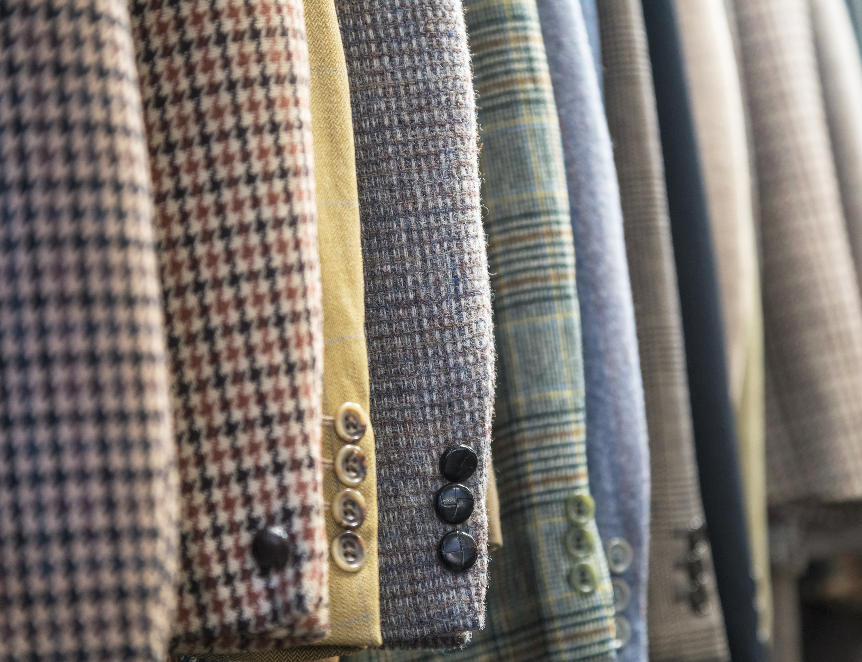
Thank you

